Slide 1

CONCEPT OF BRANDING AND BRAND IMAGE
NAME: NAISARGI SUNIL KOTHARI
BRANCH: SY IT-1, SEM 3
ID NO.: 16BEITV109
ER NO.: 160410116051
SUBJECT: EEM

Slide 2
What is Branding?
The process involved in creating a unique name and image for a product in the consumers' mind, mainly through advertising campaigns with a consistent theme. Branding aims to establish a significant and differentiated presence in the market that attracts and retains loyal customers.

Slide 3
Branding is the process of giving a meaning to specific products by creating and shaping a brand in consumers’ minds. It is a strategy designed by companies to help people to quickly identify their products and organization, and give them a reason to choose their products over the competition’s, by clarifying what this particular brand is and is not.
The objective is to attract and retain loyal customers by delivering a product that is always aligned with what the brand promises.
As discussed above, a brand provides consumers with a decision-making-shortcut when feeling indecisive about the same product from different companies.

Slide 4
PRODUCT:
“Broadly, a product is anything that can be offered to a market to satisfy a want or need, including physical goods, services, experiences, events, persons, places, properties, organizations, information, and ideas” (Kotler & Keller, 2015).
This means that a product can be anything from a hotel stay, a flight, a language course, to clothes, food, a toothbrush etc.
To illustrate the definition of a product and the role it occupies in defining branding, we will use the example of water:
Water is a free resource that every human being needs to live and survive. Yet it became a product the day humans and companies started to commercialize it, for example by selling mineral water in glass and plastic bottles.
But water always looks the same, isn’t it? It is liquid and transparent. So, how can different companies sell the same product but still convince people to purchase their bottled water instead of the one from the competition?
The answer is: by creating a brand.

Slide 5
Brand
“A brand is a name, term, design, symbol, or any other feature that identifies one seller’s good or service as distinct from those of other sellers” (American Marketing Association).
You can consider a brand as the idea or image people have in mind when thinking about specific products of a company, both in a practical (e.g. “the shoe is light-weight”) and emotional way (e.g. “the shoe makes me feel powerful”). It is therefore not just the physical features that create a brand but also the feelings that consumers develop towards the company’s product. This combination of physical and emotional cues is triggered when exposed to the name, the logo, the visual identity, or even the message communicated

Slide 6
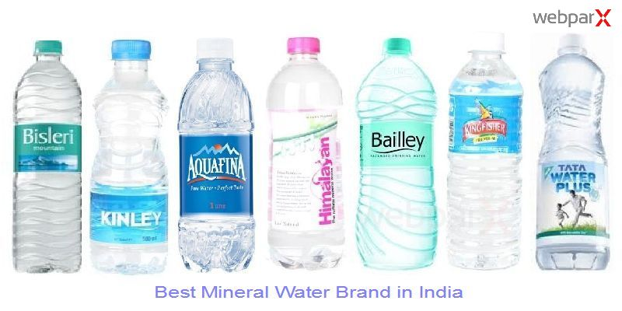
Let’s illustrate this again with our water example. The product sold is water, but in order to convince people to purchase a particular water, companies developed different water brands. And each one of these brands provides a different meaning to the product water.
Kinley
Bisleri
Aquafina
Himalayan
Bailley
Kingfisher

Slide 7
BRAND IMAGE:
Brand image is the current view of the customers about a brand. It can be defined as a unique bundle of associations within the minds of target customers. It signifies what the brand presently stands for. It is a set of beliefs held about a specific brand. In short, it is nothing but the consumers’ perception about the product. It is the manner in which a specific brand is positioned in the market. Brand image conveys emotional value and not just a mental image. Brand image is nothing but an organization’s character. It is an accumulation of contact and observation by people external to an organization. It should highlight an organization’s mission and vision to all. The main elements of positive brand image are- unique logo reflecting organization’s image, slogan describing organization’s business in brief and brand identifier supporting the key values.

Slide 8
Brand elements
name: the word or words used to identify a company, product, service, or concept
logo: the visual trademark that identifies a brand
tagline or catchphrase: LIC, Jio, KFC, McDonald’s, Raymond
graphics: the "dynamic ribbon" is a trademarked part of Coca-Cola's brand
shapes: the distinctive shapes of the Coca-Cola bottle and of the Volkswagen Beetle are trademarked elements of those brands
colors: the instant recognition consumers have when they see Tiffany & Co.’s robin’s egg blue. Tiffany & Co.’s trademarked the color in 1998.
sounds: a unique tune or set of notes can denote a brand. Apple's iPhone’s chimes provide a famous example.
scents: the rose-jasmine-musk scent of Chanel No. 5 is trademarked
tastes: Kentucky Fried Chicken has trademarked its special recipe of eleven herbs and spices for fried chicken
movements: Lamborghini has trademarked the upward motion of its car doors

Slide 9

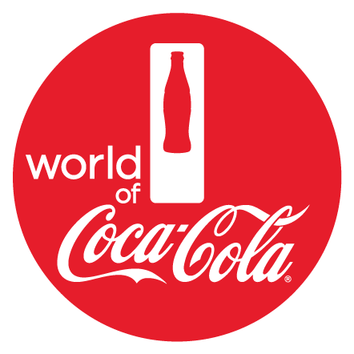
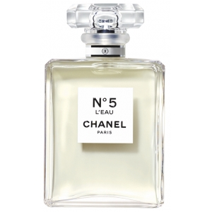
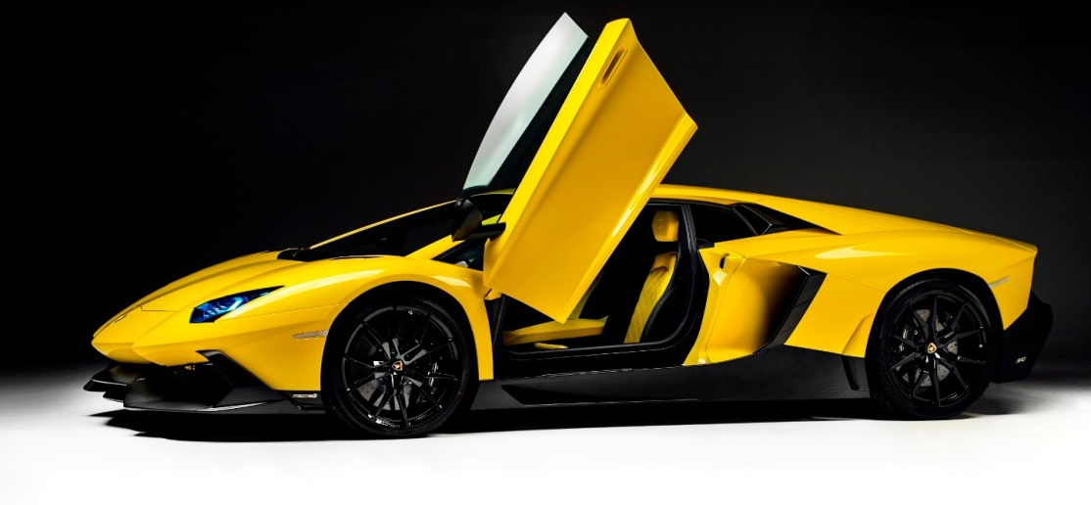

Slide 10
Brand image is a very important parameter when it comes to brand performance. If the brand image is positive, the product would rise which would result in more sales. Negative brand image will lead to opposite results. Every company should try to be realistic while identifying the brand identity of the product. This identity should be practical, objective and smart. If it is too ambitious it may lead to customers not forming the same brand image in their mind. A positive brand image is built when customers are able to recall the brand and its uniqueness in terms of the offered value proposition, relate to the organization’s way of business and its key values. Hence the Brand Image is important because it is formed completely on its own in customer's mind and cannot be measured quantitatively. Brand image can be influenced through a good brand identity which a company can control.

